Slide 1


Mapping Road Mishaps
A Data Engineering Study of car accidents Trends

Slide 2

Sowjanya kamineni
- Data Engineer
Ramya Sree Manubramha
- ML Engineer
Ganga Vamsik
- Data Architect

Slide 3
PROBLEM
Identifying hotspot locations of car accidents
Studying the impact of environmental effects
Casualty Analysis

Slide 4

STATISTICS
In 2023
5.2M car accidents as per reports
In 2022
4.8M car accidents as per reports
In 2021
4M car accidents as per reports

Slide 5

In order to predict auto accidents, we will compute real-time accident prediction, examine hotspot regions for auto accidents, analyze casualty data, and derive cause and effect principles.
To see how the degree of severity varies with weather, plot the severity against temperature, humidity, and weather.

Slide 6
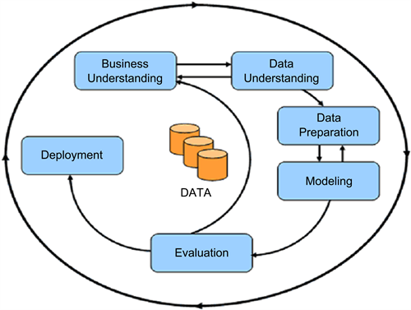
CRISP - DM

Slide 7







Graphical Representation

Slide 8
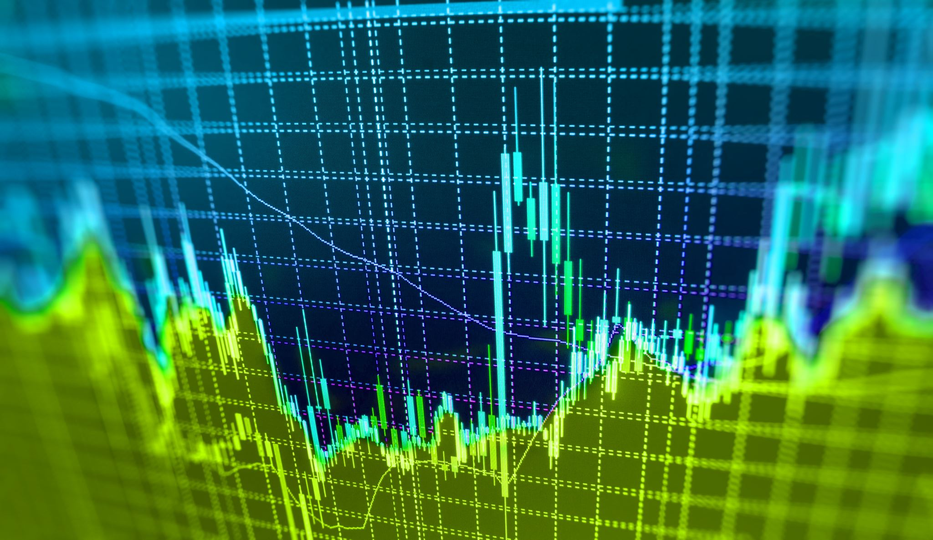
Data Understanding
The historical data on auto accidents in the United States is derived from Open Data sources.​
The dataset, which describe the accident location
Cause severity of 7,728,394 rows.

Slide 9
Data Preparation
The data was gathered from publicly available sources and posted to Git.
Data analysis tools such as pandas , numpy and others should be used to examine the data that has been collected from diverse sources using a variety of approaches.
On the input data, we also carried out exploratory data analysis or EDA.

Slide 10
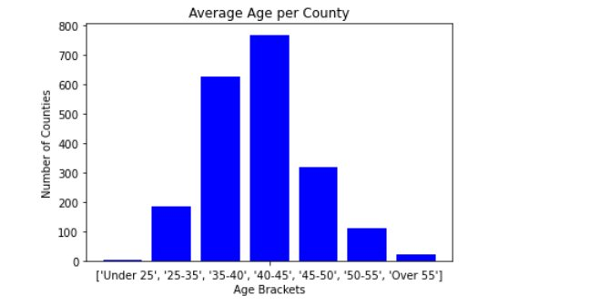
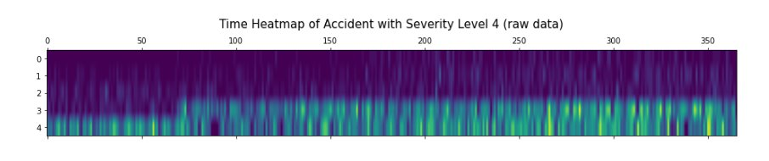
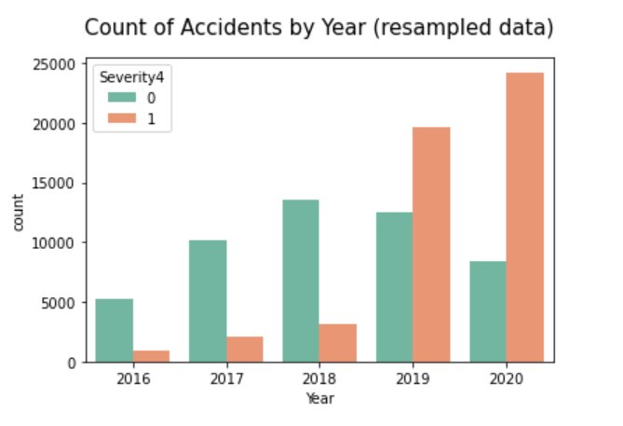
EDA

Slide 11

Modelling & Evaluation
Build a random forest , K-NN and navies bayes algorithm to decide the car accidents
The k-nearest neighbor’s algorithm also known as KNN supervised learning classifier.
Used a Flask application to deploy the result reports.

Slide 12
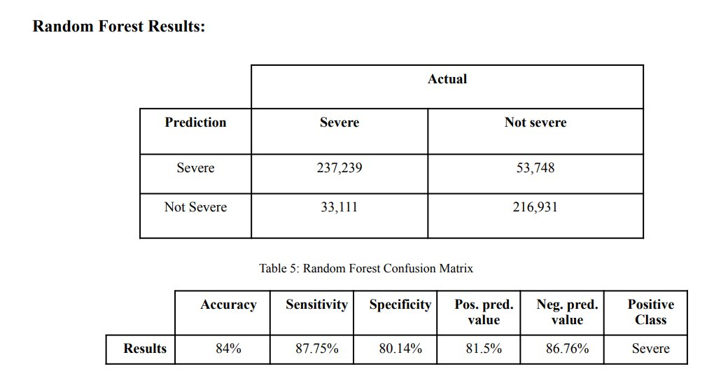
Results

Slide 13
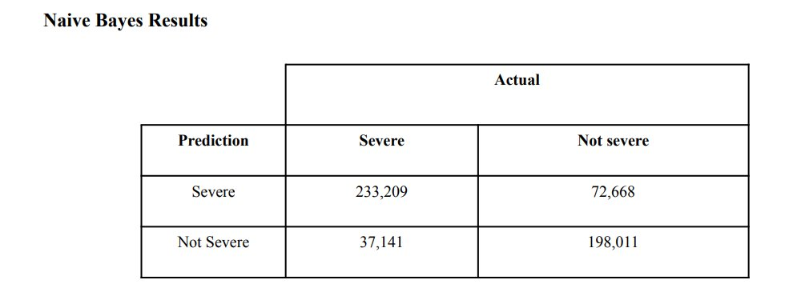

Slide 14

Deployment

Slide 15
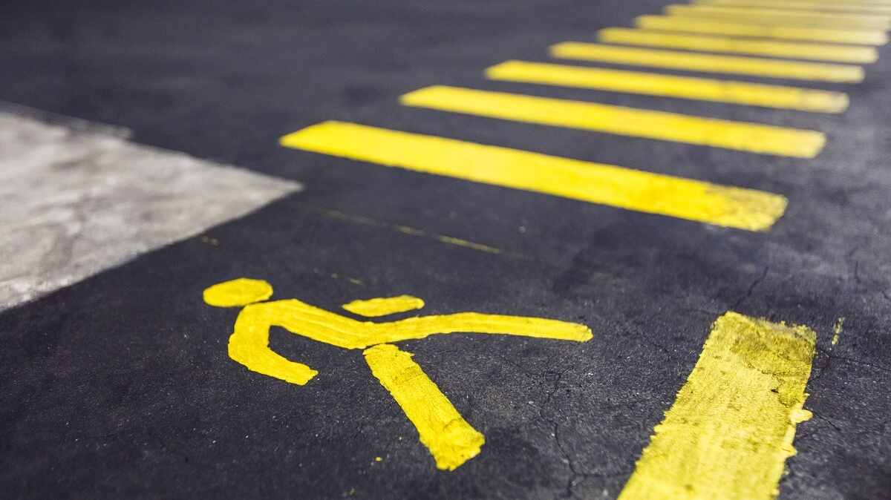
With the help of this project, we may draw conclusions about/analyze auto accidents according to city, weather, distance, temperature, pressure, and wind conditions. We'll forecast the areas of significant hotspots and auto accidents. The primary causes of the mishaps that we shall display on the visualizations.
CONCLUSION

Slide 16

THANK YOU

